Slide 1
Embedded System
Embedded system
A system whose principal function is not computational, but which is controlled by a computer embedded within it.

Slide 2
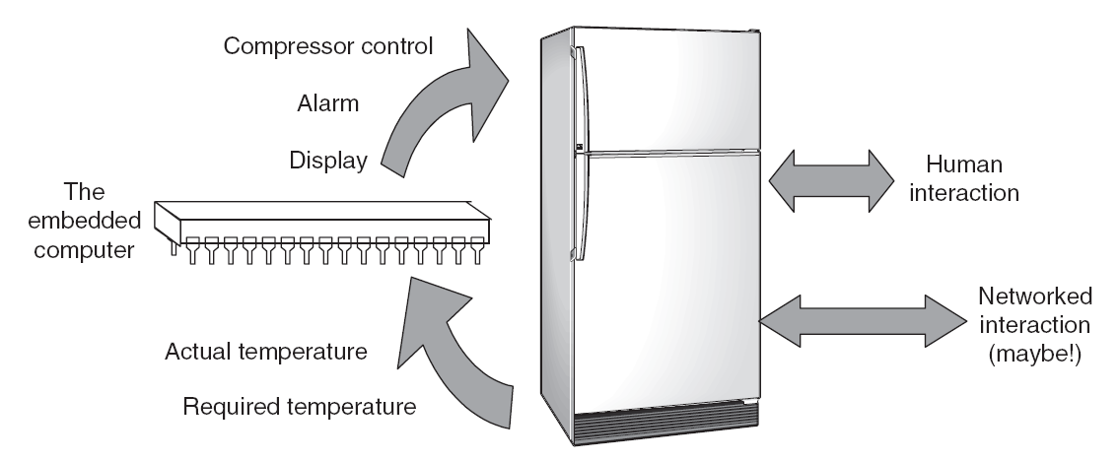
Example: Refrigerator

Slide 3
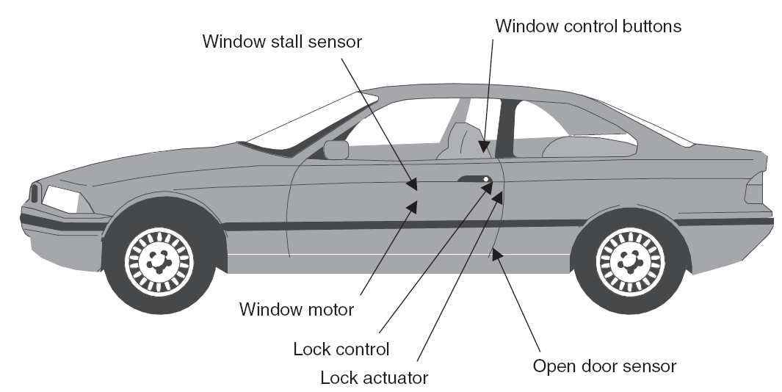
Example: Car Door

Slide 4
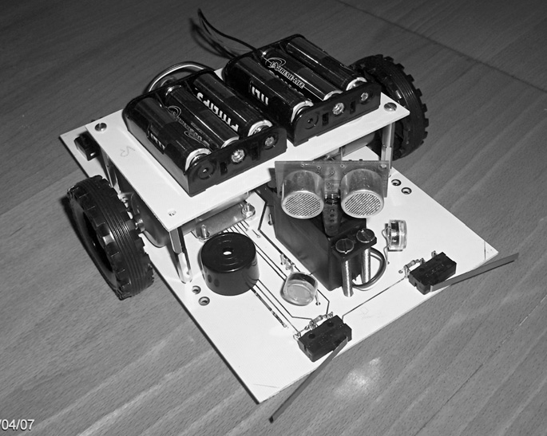
Example: Derbot Autonomous Guided Vehicle

Slide 5
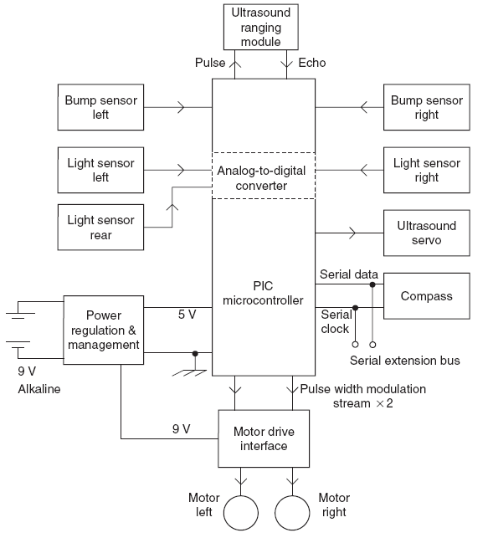
Example: Derbot Autonomous Guided Vehicle

Slide 6
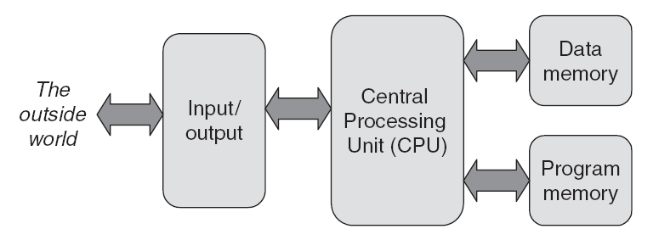
Computer Essentials

Slide 7
Computer Essentials
Instruction Sets
CISC: Complex Instruction Set Computer
RISC: Reduced Instruction Set Computer
Memory Types
Volatile: Random Access Memory (RAM)
Non-volatile: Read Only Memory (ROM)

Slide 8
RISC and CISC
RISC
Simple instruction set
Regular instruction format
Simple address modes
Separate data and program memory
Operations are reg to reg
Large number of CPU regs
Simpler to design and debug code
CISC
Complex instruction set
Irregular instruction format
Complex address modes
Combined data and program memory
Operations are reg to mem
Small number of CPU regs
Code design and debug cycles are complex

Slide 9
Microprocessors and Microcontrollers
The microprocessor is a processor on one silicon chip.
The microcontroller is a microprocessor with added circuitry.

Slide 10
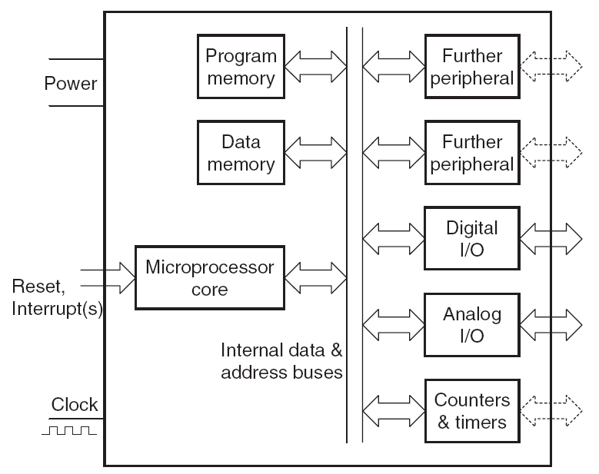
Microcontroller

Slide 11
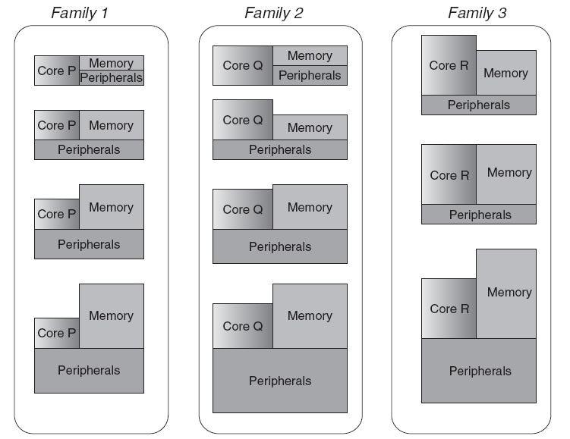
Microcontroller Families

Slide 12
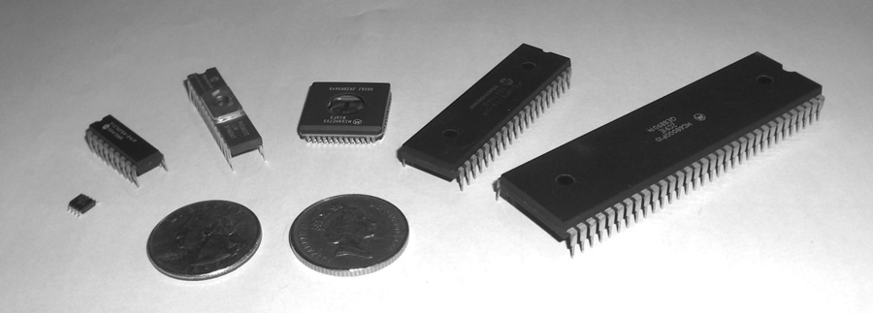
Microcontroller Packaging and Appearance
From left to right: PIC 12F508, PIC 16F84A, PIC 16C72, Motorola 68HC05B16, PIC 16F877, Motorola 68000

Slide 13
PIC Microcontrollers
Peripheral Interface Controller (PIC) was originally designed by General Instruments
In the late 1970s, GI introduced PIC® 1650 and 1655 – RISC with 30 instructions.
PIC was sold to Microchip
Features: low-cost, self-contained, 8-bit, Harvard structure, pipelined, RISC, single accumulator, with fixed reset and interrupt vectors.

Slide 14
PIC Families
PIC Family | Stack Size | Instruction Word Size | No of Instructions | Interrupt Vectors
12CX/12FX | 2 | 12- or 14-bit | 33 | None
16C5X/16F5X | 2 | 12-bit | 33 | None
16CX/16FX | 8 | 14-bit | 35 | 1
17CX | 16 | 16-bit | 58 | 4
18CX/18FX | 32 | 16-bit | 75 | 2
‘C’ implies CMOS technology; Complementary Metal Oxide Semiconductor
‘F’ insert indicates incorporation of Flash memory technology
Example: 16C84 was the first of its kind. It was later reissued as the 16F84, incorporating Flash memory technology. It was then reissued as 16F84A.

Slide 15
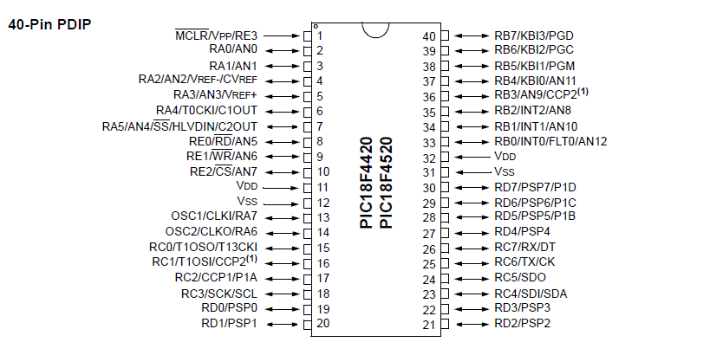
PIC18F4520 Pin-out

Slide 16
PIC18 Assembly
Assembly language instruction format
[label] [mnemonic] [operands] [;comment]
Assembler directives
ORG
EQU
SET
LIST
END
#include
_config
radix

Slide 17
Assembly instructions
Byte-oriented file-register operations
MOVWF, ADDWF, CLRF, DECF
Bit-oriented file-register operations
BCF, BTFSC
Literal instructions
MOVLW, ADDLW
Control operations
BRA, BNZ, CALL, RETURN

Slide 18
PIC18 Assembly – destination register
An operation can have 2 possible destinations:
W or F (the file-register)
The destination is specified by a flag d (f/w)
ADDWF Freg, d <- general format
Example:
ADDWF Freg, f <- Freg is the destination
ADDWF Freg, w <- w is the destination
- The default is d==f so f is the default destination

Slide 19
PIC18 Assembly: ALU with W and Freg
ADDWF Freg, d (add Freg to W)
ADDWFC Freg, d (with carry)
ANDWF Freg, d (AND Freg with W)
IORWF Freg, d (inclusive OR Freg with W)
SUBWF Freg, d (subtract Freg from W)
SUBWFB Freg, d (with borrow)
SUBFWB Freg, d (subtract W from Freg)
XORWF Freg, d (exclusive OR Freg with W)

Slide 20
PIC18 Assembly: Freg instructions Byte-oriented
MOVWF Freg
Complement and negatives
COMF Freg, d (complement Freg) => 1 to 0, 0 to 1
NEGF Freg, d (negate Freg) => 2’s complement
Rotates
RLCF, RLNCF Freg, d (rotate left Freg with/without carry)
RRCF, RRNCF Freg, d (rotate right…)
Swaps
SWAPF Freg, d (swap nibbles in Freg)
Increment, Decrement
Skipless
DECF Freg, d (decrement Freg)
INCF Freg, d (increment Freg)
Skipful
DECFSZ Freg, d (skip if zero) -> similarly, DECFSNZ
INCFSZ Freg, d (skip if zero) -> similarly, INCFSNZ

Slide 21
PIC18 Assembly: Freg instructions Bit-oriented
Skip-less
BTG Freg, X (bit toggle the X-th bit of Freg)
BSF Freg, X (set the X-th bit of Freg)
BCF Freg, X (clear the X-th bit of Freg)
Skipful
BTFSS Freg, X (bit test X-th bit of Freg, skip if it is set)
BTFSC Freg, X (bit test X-th bit of Freg, skip if it is clear)

Slide 22
File reg to file reg MOV
MOVFF Freg1, Freg2

Slide 23
Control decisions on Status flag bits
BC, BNC (carry)
BZ, BNZ (zero)
BN, BNN (negative bit)
BOV, BNOV (overflow)

Slide 24
Looping (1/3)
Add 5 to W 4 times
Brute force instruction issue
MOVLW 0
ADDLW 5
ADDLW 5
ADDLW 5
ADDLW 5
Boring code
Too many instructions eat up ROM space

Slide 25
Looping (2/3)
Add 5 to W 4 times
Using loop and conditional branching (BNZ)
CNTREG EQU h’25’
CNT EQU h’4’
ORG 0
MOVLW CNT
MOVWF CNTREG
MOVLW 0
BACK ADDLW h’5’
DECF CNTREG,F
BNZ BACK
GOTO $

Slide 26
Looping (3/3)
Add 5 to W 4 times
Using a loop and skipful branching
CNTREG EQU h’25’
CNT EQU h’4’
ORG 0
MOVLW CNT
MOVWF CNTREG
MOVLW 0
BACK ADDLW h’5’
DECFSZ CNTREG, F
GOTO BACK
GOTO $

Slide 27
Nested loops
Using a single FReg as a counter limits us to 0xFF (255)
For larger values, we have to use nested loops (loops inside loops)
2 Freg’s can give us a max of 255^2 (65025)
3 Freg’s can give us a max of 255^3 (~16 million)

Slide 28
Short and Long Jumps
All conditional branches are 2-byte instructions, leaving only 1 byte for the jump-to address
Hence, the jump-to address range is 256 bytes (-127 to +128)

Slide 29
Unconditional Branching
GOTO
4-byte instruction, so 20 bits available for the jump-to address
Long jump, can address the entire 2M space
BRA
2-byte instruction, so only 11 bits available for the jump-to address
Range of 2048 (-1024 to +1023)
Jumping to “Self”
Replace
HERE GOTO HERE
by
GOTO $

Slide 30
Subroutines and Calls
CALL
4-byte instruction, 20 bits for jump-to address
The CPU saves the address (PC) of the “next” instruction on the “stack”
Returns to the caller by RETURN statement
…
CALL FUNC
MOVLW d’5’ ; this location address is saved on SP
…
FUNC MOVLW d’2’
NOP
ADDLW d’4’
RETURN
RCALL
2-byte instruction, 11 bits for jump-to address
Jump range restricted to 2048
-> RCALL saves ROM space when jumps are short

Slide 31
Stack and Stack Pointer
SP is 21-bit wide since the PC is 21-bit wide
PIC18 has a 32-deep stack
So SP can take values from 0x00 to 0x1F
The stack is a LIFO
CALL, RCALL instructions use the PUSH/POP functionality to save the PC
Upper limit of stack is 31
So only 31 nested CALLS, RCALLS

Slide 32
Generating Delay using CALL and Loop
Implementing a “delay” function
COUNT EQU 0x30
ORG 0
…
CALL DELAY
….
ORG 0x300
DELAY MOVLW h’20’
MOVWF COUNT
LOOP NOP
NOP
NOP
DECF COUNT, F
BNZ LOOP
RETURN

Slide 33
Addition (unsigned numbers)
Addition (ADDLW, ADDWF, ADDWFC)
Unsigned numbers
Packed BCD numbers
Eg. 0x17 + 0x28 = 0x3F but result should be 0x45
We need to add 0x6 to the lower digit to make it packed BCD
Eg. 0x52 + 0x87 = 0xD9 but result should be 0x139
We need to add 0x6 to the upper digit to make it packed BCD
This addition of 0x6 is taken care of by DAW instruction
It senses whether the DC bit (auxiliary carry) is 1 or 0
If lower nibble > 9, add 0x6 to it
If upper nibble > 9, add 0x6 to it

Slide 34
Subtraction (unsigned numbers)
PIC18 uses the 2’s complement for subtraction
2’s complement: Negate all bits, add 1
“Subtract W from L/F” instructions:
SUBLW K (W = K-W)
SUBWF FREG, W (W = FREG – W)
SUBWF FREG, F (FREG = FREG – W)
If N is 0 and C is 1 result is positive
If N is 1 and C is 0 result is negative and destination has 2’s complement; use NEGF W to get the positive counterpart
SUBWFB (with borrow)
“Subtract F from W” instructions
SUBFWB

Slide 35
Multiplication, Division (unsigned)
Unsigned numbers
Multiplication
MULLW K (W = W*K)
MULWF FREG, d (d = W*FREG)
Byte by byte (8-bit x 8-bit)
16-bit result goes to SFR’s PRODH:PRODL
Division
PIC18 does not have explicit division instruction
Perform division by repeated subtraction

Slide 36
Signed numbers
Addition / subtraction result for signed numbers needs to be “adjusted”
PIC18 indicates this by setting Overflow (OV) flag to 1
If N is 0 result is positive, else negative
If OV is 1, there has been an overflow
NEGF may be used in conjunction with BOV, BNOV to adjust the result

Slide 37
Logic instructions
Logical
ANDLW, IORLW, XORLW
Negation
COMF, NEGF
Comparison
CPFSGT (FREG > W)
CPFSEQ (FREG == W)
CPFSLT (FREG < W)

Slide 38
Addressing modes
Immediate addressing
Put literals in the instruction itself
MOVLW h’4f’
Register direct addressing
Insert literal into W and move it to Freg
MOVLW h’4f’
MOVWF 0x40
Move data between Fregs
MOVFF 0x40, 0x50
Register indirect addressing
Use special “pointer” and “index” registers
Indexed ROM

Slide 39
Register indirect addressing
The concept is similar to pointers in C
Fill up a “pointer register” FSRnH:FSRnL
Three such pointer regs
12-bits wide: FSRnL is 8 low bits, FSRnH is 4 higher bits
Access data through “index register” INDFn
LFSR 0, 0x20 ; load FSR0 with 0x20
MOVWF INDF0 ; move from W to memory ; pointed to by FSR0 (ie. 0x20)
Incrementing FSRnL, FSRnH
Special instructions needed to increment FSRnL or FSRnH

Slide 40
FSR auto-increment options
We saw that INCF only works on FSRnL or FSRnH
The carry from low to high is never taken care of!
There are auto-increment options to take care of this
POSTINCn ;akin to i++
PREINCn ;akin to ++i
POSTDECn ;akin to i--
PLUSWn ;changes memory location [FSRn + Wreg]
The auto-increment / auto-decrement affects all 12bits of the pointer register
But it does not affect the STATUS register bits (C, N, Z, OV)!

Slide 41
Auto-increment example
Move 10 bytes from 0x30 to 0x60
CNT EQU h’A’
CNTREG EQU 0X20
MOVLW CNT
MOVWF CNTREG
LFSR 1, 0X30
LFSR 2, 0X60
AGN MOVF POSTINC1, W
MOVWF POSTINC2
DECF CNTREG, F
BNZ AGN

Slide 42
Indexed ROM / Table processing
PIC18 can store data in code space
The DB (define byte) directive is used to store decimal/hex/binary values and strings
Examples:
ORG h’50’
VAL1 DB h’56’
VAL2 DB d’32’
VAL3 DB b’00011000’
VAL4 DB ‘r’
VAL5 DB “Hello world!”
SFR’s to address ROM code space
Pointer: TBLPTR
TBLPTR is a 21-bit wide register
TBLPTRL, TBLPTRH, TBLPTRU
Latch: TABLAT
Keeps the byte once it is fetched through the TBLPTR
Instructions that use TBLPTR:
TBLRD* ; Simple read
TBLRD*+ ; Read and increment
TBLRD*- ; Read and decrement
TBLRD+* ; Pre-increment and read

Slide 43
Table processing example
Move a null-terminated string from ROM location 0x400 to RAM location 0x30
ORG 0
MOVLW 0
MOVWF TBLPTRL
MOVLW h’4’
MOVWF TBLPTRH
LFSR 1, 0x30
B1 TBLRD*+
MOVF TABLAT, W
BZ EXIT
MOVWF POSTINC1
BRA B1
EXIT GOTO $
ORG 0x400
STRING DB “This is nice!",0
END

Slide 44
Implementing lookup tables
Use PCL, CALL and RETLW for implementing look-up tables
Example: Use a lookup table for squaring an input number (0<x<9) read from PORTB and sending to PORTC
SETF TRISB
CLRF TRISC
MOVF PORTB, W
ANDLW 0xF, W
CALL SQR_TABLE
MOVWF PORTC, F
SQR_TABLE MULLW h’2’
MOVFF PRODL, W
ADDWF PCL
RETLW d’0’
RETLW d’1’
RETLW d’4’
RETLW d’9’
….
RETLW d’81’

Slide 45
Modular programming: Macros
Macros are used to automate repeated tasks (like moving data)
They take “dummy” arguments
Syntax
Name MACRO dummy1, dummy2,… ; dummy variables
LOCAL local1, local2, … ; local labels, if used
…
…
ENDM
Example:
Macro definition
MV_DATA MACRO K, MYREG
MOVLW K
MOVWF MYREG
ENDM
Macro usage
MV_DATA 0x44, 0x20
VAL1 EQU 0x10
VAL2 EQU 0x20
MV_DATA VAL1, VAL2
The LOCAL keyword for macro labels prevents multiple occurences of the label when the macro is called from multiple places in the code

Slide 46
Modular programming: Modules
PIC18 assembly supports linking code from several independent pieces of object code from several files
These are called modules
There are concepts of EXTERN and GLOBAL in assembly as well
These concepts apply to names (labels) and variables
GLOBAL name1
These tell the linker to “expose”/ “export” name1 at all modules
EXTERN name1
These signal to the linker that name1 is defined elsewhere
Modules are “linked” together to get the final executable “hex” file
Use the PIC linker (eg, MPLink.exe)

Slide 47
Module example
Main.asm
MYREG EQU 0x10
EXTERN COMPUTE
ORG 0
MOVF MYREG, W
CALL COMPUTE
MOVWF PORTB
END
Compute.asm
GLOBAL COMPUTE
PGM CODE
COMPUTE MULLW h’2’
MOVFF PRODL, W
RETURN
END

Slide 48
CONFIG registers
CONFIG registers control the behaviour and enable/disable features of the PIC18
CONFIG registers start at 0x300001 and go up to 0x30000D
Main registers:
0x300001 => CONFIG1H (Oscillator selection)
0x300002 => CONFIG2L (Brown out)
0x300003 => CONFIG2H (Watchdog enable)

Slide 49
CONFIG1H
Used for oscillator selection
OSCSEN: Active low input
1 => CPU switches to internal system clock 32 KHz
Very low power applications (nanoWatt range)
0 => Switching to internal clock system disabled
CPU has to use external oscillator on OSC1, OSC2 pins
FOSCn: Oscillator selection bits
000 Low power (LP 32 kHz to 200 kHz)
001 Crystal oscillator (XT 200 kHz to 1 MHz)
010 Hispeed oscillator (HS 4 Mhz to 25 MHz)
011 RC oscillator
100 External clock with OSC2 as /4 clock output
101 External clock with OSC2 as RA6
110 Hispeed oscillator with PLL enabled 4 * Fosc (HS PLL)
111 RC oscillator with OSC2 as RA6
OSCSEN
FOSC2
FOSC1
FOSC0

Slide 50
CONFIG2L
Reset and brown out voltage control
PWRTEN: Active low power-up timer control
1 => PWRT enabled
0 => PWRT disabled
BOREN: Brown out reset control
1 => Enabled
0 => Disabled
BORV0,1: Brown out reset voltage bits
00 => 4.5V
01 => 4.2V
10 => 2.7V
11 => 2.0V
BORV1
BORV0
BOREN
PWRTEN

Slide 51
CONFIG2H
Watchdog timer control
WDTEN: Watchdog timer control
1 => Enabled
0 => Disabled
WDTPSn: Postscale select bits
000 => 1:1
001 => 1:2
…
111 => 1:128
WDTPS2
WDTPS1
WDTPS0
WDTEN

Slide 52
CONFIG4L
Controls:
Enabling/disabling background debugger (DEBUG)
Uses RB6,7 for in-circuit debugger if enabled
Enabling/disabling low voltage ICSP (LVP)
Uses RB5 for ICSP
Enabling/disabling stack overflow reset (STVR)
Stack overflow will reset the CPU

Slide 53
MPLAB MPASM CONFIG settings
LIST P=P18F452
#include P18F4520.inc
CONFIG OSC=HS
CONFIG WDT=OFF
CONFIG PWRT=OFF
CONFIG DEBUG=OFF, LVP=OFF, STVREN=OFF

Slide 54
C programming (finally!)
PIC18 supports high-level languages like C
We need C compilers to code and program in C
Free compilers produce “decent” code
Paid compilers produce “good” code
Even after using paid / licensed compilers, most applications would need hand-coding of key assembly modules
Examples of compilers
MCC18
Microchip’s XC18
HiTech’s PIC C compiler

Slide 55
PIC18 C: Datatypes
Datatype
Size
unsigned char
char
unsigned int
int
unsigned short
short
unsigned short long
short long
unsigned long
long
8-bit
8-bit
16-bit
16-bit
16-bit
16-bit
24-bit
24-bit
32-bit
32-bit

Slide 56
PIC18 C: Code example
#include <P18F4520.h>
void main(void)
{
unsigned char z=0, max=10;
unsigned char cnt;
TRISB = 0;
for (cnt=0;cnt<max;cnt++)
PORTB = z;
return;
}
Set the proper “include” and “library” directory paths in “Build Options”
C:\MCC18\H and C:\MCC18\LIB
C projects also need a “linker command file”
For PIC18F4520 the linker file is 18F4520.lkr
Available in C:\MCC18\LKR\

Slide 57
PIC18 C: I/O programming
I/O ports are available as TRISx and PORTx
Bits of I/O ports and TRIS’s are available as
PORTxbits.Rxn (PORTBbits.RB0)
TRISxbits.TRISxn (TRISBbits.TRISB3)

Slide 58
I/O port programming in C
Read bit 2 of PORTC, send it to bit 3 of PORTB
#include <P18F4520.h>
#define IN PORTCbits.RC2
#define OUT PORTBbits.RB3
void main(void)
{
unsigned char t;
TRISCbits.TRISC2 = 1;
TRISBbits.TRISB3 = 0;
while (1)
{
t = IN;
OUT = t;
}
return;
}

Slide 59
Talking serial with ports in C
Send a byte 0x23 serially on RC5, MSB first
#include <P18F4520.h>
#define OUT PORTCbits.RC5
void main(void)
{
TRISCbits.TRISC5 = 0;
unsigned char i, tmp, byte=0x23;
tmp = byte;
for (i=0;i<8;i++)
{
OUT = (tmp>>7)&0x01;
tmp = tmp<<1;
}
return;
}

Slide 60
Talking parallel with ports in C
Move a byte 0x23 to PORTC
#include <P18F4520.h>
void main(void)
{
TRISC = 0;
unsigned char byte = 0x23;
PORTC = byte;
return;
}

Slide 61
Code and data placement: ROM
Data
The keyword “rom” places data in ROM memory (instead of data memory which is the default)
rom char string[] = “Hello”;
Placement can be made exact through #pragma romdata
#pragma romdata rombank1 = 0x200
rom unsigned char mystring[] = “Hello”;
Code
We use #pragma code to place code at a particular memory location
#pragma code main = 0x50

Slide 62
MPLAB MCC18 “C” CONFIG settings
#pragma config OSC=HS
#pragma config WDT=OFF
#pragma config PWRT=OFF
#pragma config DEBUG=OFF, LVP=OFF, STVR=OFF
#include <P18F4520.h>
// C code follows

Slide 63
PIC18 Timers
PIC18 has 2 - 5 timers
Timer0, … Timer4
Timers may be 8-bit or 16-bit wide
Accessed as TMRxH, TMRxL
Each timer has a control register
Accessed as TxCON
Timers can be used for timing (CPU independent) or as event counters

Slide 64
PIC18 Timer0 T0CON (1/2)
16-bit timer reg TMR0H:TMR0L, Control register T0CON
TMR0ON: Timer on/off bit
T08BIT: 1=> 8-bit, 0 => 16-bit
T0CS: TMR0 clock source select
1 => external clock from RA4/T0CKI pin
0 => internal clock (Fosc/4) from XTAL
T0SE: TMR0 edge select
1 => count H-to-L, 0 => count L-to-H
PSA: Prescaler assignment bit
1 => prescaler bypassed, 0 => clock input comes from prescaler
TMR0ON
T08BIT
T0CS
T0SE
PSA
T0PS2
T0PS1
T0PS0

Slide 65
PIC8 Timer0 T0CON (2/2)
T0PS0,1,2 prescaler bits
000 => 1:2 Fosc/4/2
001 => 1:4 Fosc/4/4
010 => 1:8 Fosc/4/8
011 => 1:16 Fosc/4/16
100 => 1:32 Fosc/4/32
101 => 1:64 Fosc/4/64
110 => 1:128 Fosc/4/128
111 => 1:256 Fosc/4/256

Slide 66
PIC18 Timer0 Usage
TMR0IF bit (Bit 2) of INTCON register gets set when TMR0 overflows
8-bit overflow from 0xFF to 0x00
16-bit overflow from 0xFFFF to 0x0000
Methods to use overflow:
Set off TMR0 by setting TMR0ON bit to 1, and monitoring TMR0IF continuously in a loop
Other option is to make TMR0 generate an interrupt and handle this interrupt in a timer ISR

Slide 67
PIC18 Timer0 programming
General procedure
Main code
Load T0CON with config bits (keep TMR0ON at 0)
Load TMR0H:TMR0L with appropriate values
Clear TMR0IF bit of INTCON
Call the function TMR_DELAY
Perform time toggling / delay dependent work
TMR_DELAY
Start timer (set TMR0ON to 1)
Keep checking TMR0IF in a loop
If set, stop timer and clear interrupt bit
Return

Slide 68
PIC18 Timer0 programming example
Generate a square wave of 2 kHz on RB4 for XTAL clock @ 10MHz
Finding value of TMR0H:TMR0L
(delay generated by TMR_DLY)
BCF TRISB, 4
MOVLW h’08’
MOVWF T0CON
L1 MOVLW h’FD’
MOVWF TMR0H
MOVLW h’8F’
MOVWF TMR0L
BCF INTCON, TMR0IF
CALL TMR_DLY
BTG PORTB, 4
BRA L1
TMR_DLY BSF T0CON, TMR0ON
BTFSS INTCON, TMR0IF
BRA TMR_DLY
BCF T0CON, TMR0ON
BCF INTCON, TMR0IF
RETURN
F = 2 kHz, T = 1/F = 500 usec
TMR_DLY has to generate a delay of T/2 = 250 usec
For XTAL=10MHz, and no prescaler, clock is Fosc/4
n = (10M/4)*250usec
/prescaler (if not 1:1)
Compute val = 65536 – n
Load TMR0H:TMR0L with hex value of val

Slide 69
PIC18 Timer0: Effect of prescaler
With 1:1 prescaler
The maximum delay for 16-bit timer is
65536 * 0.4usec * 2 = ~52 ms (full-wave)
The minimum frequency is
1/(65536 * 0.4usec * 2) = ~19 Hz
With 1:256 prescaler this becomes
Maximum delay
65536 * (0.4usec * 256) * 2 = ~13 secs (full-wave)
Minimum frequency
1/(65536 * 0.4usec * 256 * 2) = ~0.07 Hz

Slide 70
PIC18 Timer as a Counter
Use T0CS bit as 1
Now source becomes external oscillator
Timer becomes a counter and counts pulses
TMR0H:TMR0L hold the “number counted”
They should ideally be set to 0 before enabling TMR0 through TMR0ON
RA4 becomes T0CKI (TMR0 Clock Input)

Slide 71
PIC18 Interrupts
Interrupts improve CPU performance
CPU doesn’t have to keep “polling”
CPU switches to Interrupt’s Service Routine (ISR) to handle the interrupt
PIC18 has many kinds of interrupts
Timer interrupts
USART interrupts
PORTB change interrupts
ADC generated interrupts
CCP generated interrupts
External interrupts (hardware)

Slide 72
PIC18 Interrupts: Enabling/disabling
On boot, PIC18 has all interrupts disabled
PIC18 has 2 levels of interrupt control
Global level (GIE bit of INTCON)
Interrupt type level (example: timer interrupts TMR0IE, etc)
Timer interrupts
Interrupt | Flag bit (Register) | Enable bit (Register)
TMR0 | TMR0IF (INTCON) | TMR0IE (INTCON)
TMR1 | TMR1IF (PIR1) | TMR1IE (PIE1)
TMR2 | TMR2IF (PIR1) | TMR2IE (PIE1)
TMR3 | TMR3IF (PIR3) | TMR3IE (PIE2)

Slide 73
PIC18 Interrupt Vector Table
Vectors
Reset vector 0x0000
High priority interrupt 0x0008
Low priority interrupt 0x0018
By default, all interrupts are “high priority”
These only contain hard jumps; the actual code will lie elsewhere
If an interrupt is enabled and the interrupt occurs
GIE is disabled and the CPU jumps to this vector location
The hard jump at this location will take it to it’s ISR
The ISR returns with a RETFIE which enables GIE and returns
Handling multiple interrupts
ISR first checks which interrupt was responsible for the vector jump
And jumps to the respective interrupt’s ISR

Slide 74
PIC18 ISR template (assembly)
Vector code
ORG 0x0008
GOTO ISR_MAPPER
ISR_MAPPER code
ORG 0x0040
ISR_MAPPER BTFSC INTCON, TMR0IF
BRA TMR0_ISR
BTFSC PIR1, TMR1IF
BRA TMR1_ISR
RETFIE
TMR0_ISR code TMR1_ISR code
ORG 0x200 ORG 0x300
TMR0_ISR … TMR1_ISR …
… …
BCF INTCON, TMR0IF BCF INTCON, TMR1IF
GOTO ISR_MAPPER GOTO ISR_MAPPER

Slide 75
PIC18 ISR template (C)
Vector code
#pragma code high_vector=0x0008
void my_high_vector_intr(void)
{
_asm
GOTO ISR_mapper
_endasm
}
#pragma code
ISR_Mapper code
#pragma interrupt ISR_mapper
void ISR_mapper(void)
{
// code to check source of interrupt
if (INTCONbits.TMR0IF==1)
TMR0_ISR();
if (INTCONbits.TMR1IF==1)
TMR1_ISR();
} // C compiler puts a RETFIE
ISR code

Slide 76
PIC18 Hardware Interrupts
External pins (Multiplexed with PORTB)
INT0, INT1, INT2
Edge triggering can be controlled
By programming INTEDGx bits (part of INTCON2)
Edge triggering: positive (1) [default], negative (0)
Register mapping
Interrupt | Flag bit (Register) | Enable bit (Register)
INT0 (RB0) | INT0IF (INTCON) | INT0IE (INTCON)
INT1 (RB1) | INT1IF (INTCON3) | INT1IE (INTCON3)
INT2 (RB2) | INT2IF (INTCON3) | INT2IE (INTCON3)

Slide 77
A->D Conversion Basics
An ADC takes an analog voltage as input, converts this to digital and outputs a binary number
Terms used
Resolution (number of bits)
Commercial ADC’s can go from 8-bits to 24-bits
Higher bits gives smaller step size (finer resolution)
Conversion time
Depends on the clock and internal conversion circuitry
Vref
Reference voltage that decides the “range” /max of the ADC, and hence the step size
Digital data output of ADC
This is the binary data output from the ADC
Analog input channel
Each channel is an analog input, and can be activated through a config
Start conversion, end-of-conversion signals
Start signal signals the ADC to start the conversion process
End-of-conversion signal from ADC tells us that the conversion is complete

Slide 78
ADC calculation examples
Step size = Vref / 2^(resolution)
Ex 1: Vref=5V, 8-bit ADC gives a step size of 5/256 = 19.53mV
Ex 2: Vref=5V, 10-bit ADC gives a step size of 5/1024 = 4.88mV
Ex 3: Vref=2V, 10-bit ADC gives a step size of 2/1024 = 1.95mV
Digital data output, Dout = Vin / step size
Ex 1: Vin = 2V, Dout = 2 / 19.53 = 102 = 0b0110 0110 = 0x66
Ex 2: Vin = 4.5V, Dout = 4.5 / 4.88 = 922 = 0b0011 1001 1010 = 0x39A
Ex 3: Vin = 1V, Dout = 1 / 1.95 = 512 = 0b0010 0000 0000 = 0x200

Slide 79
PIC18 ADC
PIC18 has internal on-chip ADC
PIC18F4520 has 8 ADC channels (ANx)
Internal ADC is 10-bit
Multiplexed with PORTA (AN0-AN4) and PORTE (AN5-AN7)
2 registers control the behaviour of ADC
ADCON0 and ADCON1
Output is available in ADRES register (ADRESH:ADRESL)
10-bits valid out of 16 (right/left justified)
Vref+, Vref- can be Vdd, Vss or external
ADC is capable of generating interrupts
Interrupt flag is ADIF (part of PIR1)
Interrupt enable flag is ADIE (part of PIE1)

Slide 80
PIC18 ADCON0
ADCON0
ADON: Enable (1) / disable (0) the A-to-D feature
GO/DONE: Set GO to High to start, ADC will make it low on completion
CHS0,1,2: Channel selection (AN0 to AN7)
ADCS0,1,2: Clock source select
000 Fosc/2
001 Fosc/8
010 Fosc/32
011 Internal RC
100 Fosc/4
101 Fosc/16
110 Fosc/64
111 Internal RC
ADCS1
ADCS0
CHS2
CHS1
CHS0
GO/DONE
-
ADON

Slide 81
PIC18 ADCON1
ADCON1
ADFM: Controls the right (1) / left (0) justification of output in ADRES
ADCS2: Part of ADCON0 for deciding clock source
PCFG0,1,2,3: Control # of channels, pins for channels and Vref+, Vref-
ADFM
ADCS2
-
-
PCFG3
PCFG2
PCFG1
PCFG0

Slide 82
PIC18 ADCON1 (PCFG bits)
A is an analog ADC input channel
D is IO PORT’s digital pin
C/R indicates ratio of analog channels to number of pins used for Vref
PCFG | AN7 | AN6 | AN5 | AN4 | AN3 | AN2 | AN1 | AN0 | Vref+ | Vref- | C/R
0000 | A | A | A | A | A | A | A | A | Vdd | Vss | 8/0
0001 | A | A | A | A | Vref+ | A | A | A | AN3 | Vss | 7/1
0010 | D | D | D | A | A | A | A | A | Vdd | Vss | 5/0
0011 | D | D | D | A | Vref+ | A | A | A | AN3 | Vss | 4/1
… | … | … | … | … | … | … | … | … | … | … | …
1110 | D | D | D | D | D | D | D | A | Vdd | Vss | 1/0
1111 | D | D | D | D | Vref+ | Vref- | D | A | AN3 | AN2 | 1/2

Slide 83
PIC18 ADC Programming
Turn on the ADC module (ADCON of ADCON0)
Make the corresponding PORT pin an input
Select Vref+ and Vref- (usually Vdd and Vss)
Select ADC clock (ADCON0)
Wait for acquisition time (minimum 1.6usec)
Activate GO/DONE bit
Wait for GO/DONE to go low
Read ADRESH:ADRESL (right/left justified)

Slide 84
PIC18 ADC Code
Convert analog voltage at pin RA0 (AN0) and put the output at 0x30(H), 0x31(L) once per second
ORG 0x0
BSF TRISA, 0 ; ADC input
MOVLW 0x81 ; Fosc/64, Vdd, Vss, ADON
MOVWF ADCON0
MOVLW 0xCE ; right-justified, AN0 input
MOVWF ADCON1
L1 CALL ACQ_DELAY ; atleast 1.6 usec
BSF ADCON0, GO ; start using GO bit
L2 BTFSC ADCON0, DONE ; check for DONE bit
BRA L2
MOVFF ADRESH, 0x30
MOVFF ADRESL, 0x31
CALL 1SEC_DELAY
BRA L1

Slide 85
PIC18 CCP
PIC18 has a unique Compare-Capture-PWM (CCP) feature
Compare
Compare a TIMER register with a preloaded CCPR register and control a CCP pin output
Capture
Capture the value of a TIMER register into a CCPR register in response to a CCP pin input
PWM
Generate controlled PWM output at CCP pin, using a TIMER
PIC18 family may have 1/more CCP and 1/more ECCP modules
CCP registers (for CCP1 module, similar for others)
Control: CCP1CON (config), T3CON (timer selection)
Timer: Compare/Capture - TIMER1/ TIMER3; PWM - TIMER2
CCPR register: CCPR1H:CCPR1L (16-bit)
CCP Pins
CCP1 (output for compare, input for capture) – multiplexed with RC2
T1CKI / T3CKI (clock input for timer)

Slide 86
PIC18 CCP: CCP1CON
-
-
DC1B1
DC1B2
CCP1M3
CCP1M2
CCP1M1
CCP1M0
CCP1M0,1,2,3: CCP1 mode select
0000 CCP1 is off
0001 Reserved
0010 Compare mode – toggle CCP1 on match
0011 Reserved
0100 Capture mode – every falling edge
0101 Capture mode – every rising edge
0110 Capture mode – every 4th rising edge
0111 Capture mode – every 16th rising edge
1000 Compare mode – CCP1 init low, match high, CCP1IF set
1001 Compare mode – CCP1 init high, match low, CCP1IF set
1010 Compare mode – generate s/w interrupt, CCP1 no effect
1011 Compare mode – trigger special event , CCP1IF set, timer cleared
11xx PWM mode
DC1B1,2: Duty cycle bits used in PWM mode

Slide 87
PIC18 CCP1 T3CON bits
T3CCP1,2 (bits 5,6): Control which timer is used for CCP1 and ECCP1
CCP1 ECCP1
00 Timer1 Timer1
01 Timer1 Timer3
1x Timer3 Timer3

Slide 88
PIC18 CCP: Compare behaviour
In compare mode, PIC18 can control the behaviour of the CCP1 pin (output) when there is a “compare match”
When the contents of TIMER1 register TMR1H:TMR1L matches CCPR1H:CCPR1L
Behaviour control
Drive CCP1 high
Drive CCP1 low
Toggle CCP1
Generate a software interrupt (CCP interrupt)
Trigger a special event with a hardware interrupt and clear the timer

Slide 89
PIC18 CCP: Compare template
Initialize CCP1CON for proper compare mode
Initialize T3CON (select Timer1)
Initialize CCP regs: CCPR1H:CCPR1L
Make CCP1 (RC2) an output pin
Load Timer1 registers: TMR1H:TMR1L
Start Timer1 (TMR1ON of T1CON)
Monitor CCP1IF flag (or use CCP interrupt)
-- When Timer1 register value matches CCPR1 the CCP1 pin will exhibit desired behaviour --

Slide 90
PIC18 CCP: Compare code
Make CCP1 toggle on compare match (CCPR1 value 0x1234)
MOVLW 0x02
MOVWF CCP1CON ; compare mode, toggle on match
MOVLW 0x0
MOVWF T3CON ; select TIMER1
MOVLW 0x0
MOVWF T1CON ; internal clk, 1:1 prescale
BCF TRISC, CCP1 ; CCP1 is output
MOVLW 0x12
MOVWF CCPR1H
MOVLW 0x34
MOVWF CCPR1L ; load CCPR1 with value 0x1234
L1 CLRF TMR1H
CLRF TMR1L ; load TMR1H:TMR1L with zeros
BCF PIR1, CCP1IF ; clear previous CCP1IF
BSF T1CON, TMR1ON ; start timer
L2 BTFSS PIR1, CCP1IF ; test for match, when there is a match , CCP1IF will go high
BRA L2 ; also, CCP1 will automatically toggle
BCF T1CON, TMR1ON ; stop timer
BRA L1

Slide 91
PIC18 CCP: Capture behaviour
In capture mode, PIC18 can “capture” an event of interest at CCP1 pin (input)
And cause the contents of Timer1 register TMR1H:TMR1L to get loaded into CCPR1H:CCPR1L
Behaviour control (at CCP1 input pin)
Every falling edge
Every rising edge
Every 4th rising edge
Every 16th rising edge
Used for measuring pulse width / period of an input pulse on CCP1 pin

Slide 92
PIC18 CCP: Capture template
Initialize CCP1CON for proper capture mode
Initialize T3CON (select TIMER1)
Make CCP1 (RC2) an input pin
Wait for rising/falling edge 1 at CCP1
Initialize Timer1 register to zero
Start Timer1
Wait for rising/falling edge 2 at CCP1
Read Timer1/CCPR1 value on rising/falling edge 2
-- This is the period of the input pulse in terms of Tclk multiples [Tclk = 1/(Fosc/4)] --

Slide 93
PIC18 CCP: Capture code
Measure the period of an input pulse at CCP1 using PIC18 capture mode (output should be in 0x10, 0x11)
OUTH EQU 0x10
OUTL EQU 0x11
MOVLW 0x05
MOVWF CCP1CON ; capture mode, rising edge
MOVLW 0x0
MOVLW T3CON ; select TIMER1
MOVLW 0x0
MOVWF T1CON ; internal clock, 1:1 prescaler
BSF TRISC, CCP1 ; CCP1 is an input
CLRF CCPR1H
CLRF CCPR1L ; clear CCPR1 register
L1 CLRF TMR1H
CLRF TMR1L ; clear TIMER1 register
BCF PIR1, CCP1IF ; clear previous CCP1IF
RISE1 BTFSS PIR1, CCP1IF ; check CCP1IF for rising edge 1
BRA RISE1
BCF PIR1, CCP1IF ; clear CCP1IF for rising edge 2
BSF T1CON, TMR1ON ; start TIMER1
RISE2 BTFSS PIR1, CCP1IF
BRA RISE2
BCF T1CON, TMR1ON ; stop timer
MOVFF CCPR1H, OUTH
MOVFF CCPR1L, OUTL
GOTO $

Slide 94
PIC18 CCP: PWM
In PWM mode, PIC18 can generate a precise PWM waveform (control of frequency and duty cycle) at its CCP1 pin (output)
PWM mode uses the TIMER2
The frequency is controlled by the PR2 register value and the prescaler of TIMER2 (1:1,1:4,1:16)
Tpwm = 4*(PR2+1) * N * (1/Fosc)
Fpwm = 1/Tpwm
PR2 = [Fosc / (Fpwm * 4 * N)] – 1
PR2 max value is 255, if greater use a prescaler
The duty cycle is controlled by:
Calculate y = x% of PR2
CCPR1L register (8-bit) [integer part of y]
DC1B2:DC1B1 bits of CCP1CON [fractional part of y]
DC1B2 DC1B1 Fraction
0 0 0
0 1 0.25
1 0 0.50
1 1 0.75

Slide 95
PIC18 CCP: PWM T2CON
Bits 0,1 (T2CKPS1,T2CKPS0) of T2CON are used for deciding the pre-scaler for TIMER2
Value Pre-scaler
00 1:1
01 1:4
1x 1:16

Slide 96
PIC18 CCP:PWM examples
For Fosc = 10MHz, generate a PWM of 10 kHz frequency and 55% duty cycle
PR2 = [Fosc / (Fpwm*4*N)] – 1
= [ 10M / (10K*4*1)] – 1
PR2 = 249, prescaler 1:1
CCPR1L = 55% of 249 = 136.95 = 137 = 0x89
DC1B2:DC1B1 = 00
For Fosc = 10MHz, generate a PWM of 1kHz frequency and 35% duty cycle
PR2 = [Fosc/ (Fpwm*4*N)] – 1
= [ 10M / (1k*4*16)] – 1
PR2 = 155, prescaler 1:16
CCPR1L = 35% of 155 = 54.25 = 54 = 0x36
DC1B2:DC1B1 = 01 (0.25)

Slide 97
PIC18 CCP: PWM template
Calculate PR2, pre-scaler, CCPR1L, and DC1B2:DC1B1 values
Load PR2
Load pre-scaler into T2CON
Load CCPR1L
Make CCP1 an output pin
Clear TMR2 register
Configure CCP1CON for PWM mode, load DC1B2:DC1B1 bits
Start TIMER2

Slide 98
PIC18 CCP: PWM code
Generate a PWM of 1kHz with duty cycle of 35% at CCP1
MOVLW d’155’
MOVWF PR2 ; 1Khz
MOVLW 0x36
MOVWF CCPR1L ; 35%
BCF TRISC, CCP1 ; CCP1 pin is an output
MOVLW 0x03
MOVWF T2CON ; 1:16 prescaler
MOVLW 0x1C
MOVWF CCP1CON ; PWM mode, 0.25% left over
CLRF TMR2H
CLRF TMR2L
BSF T2CON, TMR2ON ; start TIMER2
GOTO $

Slide 99
PIC18 ECCP
ECCP is Enhanced CCP
Same compare, capture features
For PWM, instead of a single pin modulated output, it can use 4 pins
PIC18 may have 1/more ECCCP modules
ECCP registers (for ECCP1 module, similar for others)
Control: ECCP1CON (config), T3CON (timer selection)
Timer: Compare/Capture - TIMER1/ TIMER3; PWM - TIMER2
CCPR register: ECCPR1H:ECCPR1L (16-bit)
ECCP Pins
ECCP1 (output for compare, input for capture) – multiplexed with RD4
T1CKI / T3CKI (clock input for timer)
Additional pins for PWM: P1B / RD5, P1C / RD6, P1D / RD7
ECCP PWM is used for bidirectional speed control of DC motors
Without an extra H bridge

Slide 100
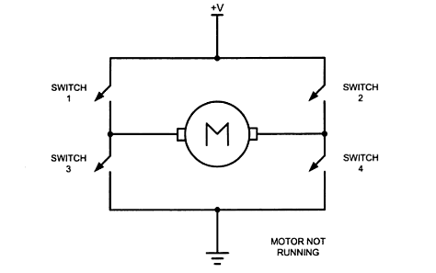
H Bridge Schematic
H bridge is used to control the speed of a DC motor in both directions
Schematic
S1 and S4 are closed, the motor rotates clockwise
S2 and S3 are closed, the motor rotates anti clockwise

Slide 101
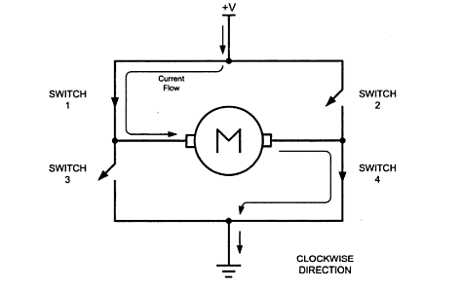
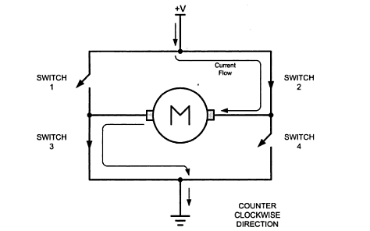
H bridge operation

Slide 102
PIC18 ECCP: Enhanced PWM
ECCP PWM has 4 PWM output pins:
P1A(ECCP1), P1B, P1C, P1D
ECCP1CON register has 2 control pins
EPWM1M1, EPWM1M0 (bits 7,6) which control the PWM behaviour
EPWM1M1 | EPWM1M0 | EFFECT
0 | 0 | P1A PWM, P1B, P1C, P1D inactive
0 | 1 | P1A PWM, P1D active, P1B, P1C inactive
1 | 0 | P1A, P1D both PWM, P1B, P1C inactive
1 | 1 | P1A inactive, P1B PWM, P1C active, P1D inactive

Slide 103
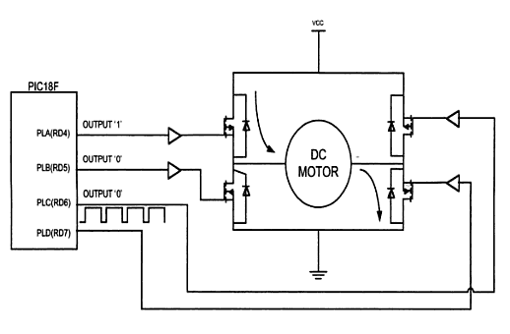
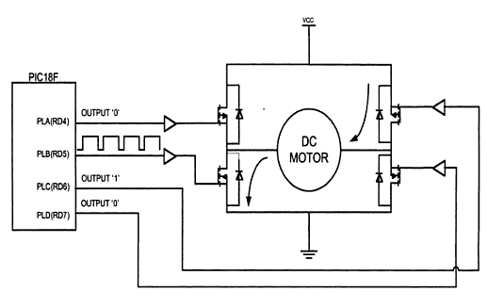
PIC18 ECCP: EPWM in action
EPWM1M1,0 is 01
P1A PWM, P1D active
Clockwise operation
EPWM1M1,0 is 11
P1B PWM, P1C active
Anticlockwise operation

